Slide 1
Hemorrhage
Assist Prof. Luay A. Naeem

Slide 2
Hemorrhage Loss of blood from the vascular system due to rupture or cutting of the blood vessels.

Slide 3
Causes:
Penterating wounds
Incision
Contusion or laceration.
Failure of blood coagulation due to
A. Liver disease
B. Excessive radiation for long period of time
C. Chemical poisoning
D. Genetic factor such as haemophelia
E. Tumors

Slide 4
Types of Hemorrhage
Depend on source :-
1. Arterial Hg: Bright red blood & flows in spurt under pressure.
2. Venous Hg: Bluish red blood & flows freely with out great force.
3. Capillary Hg: Blood is oozes under very low pressure.

Slide 6
Types of Hemorrhage
B. Depend on time
1. Primary which occurs at the time of injury.
2. Intermediate which occurs within 24 hrs of injury.
3. Secondary which occurs more than 24 hrs after the initial injury.

Slide 7
Types of Hemorrhage
C. Depend on extent
1. Petechial Hg: which denotes small hemorrhage
2. Bruising Hg: which refer to large areas of hemorrhage subcutaneouseas or submucosal.
3. Deep hemorrhage.

Slide 8
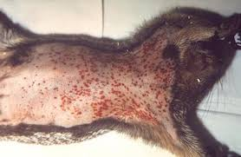
Petechial Hemorrhage

Slide 9
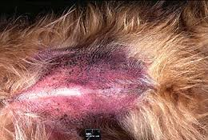
Bruising Hemorrhage

Slide 10
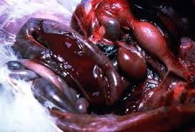
Deep hemorrhage

